Slide 1
Windows Azure, Java and NoSQL
Developing Professional Solutions with
Mario Szpuszta
Technical Evangelist
Windows Azure ISV Incubation
Microsoft Corp.
Jürgen Mayrbäurl
Principal Technical Evangelist
Developer & Platform Evangelism
Microsoft Austria
Notes:
both

Slide 2
A „realistic“ Scenario;)
Notes:
jurgenma

Slide 3
Startup Company & Book Store
„Innovative“ ☺ start-up
Become the next Amazon for professional books
But we don‘t have lot‘s of money
Experienced in development with Java & Spring
Existing on-premise implementation started
Leveraged infrastructure: Spring Framework 3.x, MongoDB
We need to be prepared for steady growth
Without big investments upfront!
Notes:
jurgenma

Slide 4
Decision for Public Cloud Platform
“On and Off “
Typical usage patterns for cloud
On-Off, bursting scenarios, continuous growth
In our example-case:
grow our resources over time with consumption
Inactivity
Period
Compute
Average
Usage
Time
“Predictable Bursting“
“Continuous Growth“
Compute
Average Usage
Time
“Unpredictable Bursting“
Compute
Average Usage
Compute
Average Usage
Time
Time
Notes:
jurgenma

Slide 5

Platform-as-a-Service…
PaaS
„Time-2-market“ is key for us
DevOps principles are success enabler!
We can‘t afford to manage „machines“
Managing virtual machines and OS means lots of effort & time
Focus must be on application
Leverage application building blocks
Continous shipment of functionality
Cloud platform will need to manage Virtual Machines and OS for us!!
Platform-as-a-Service
build
Notes:
jurgenma

Slide 6
Building on top of Windows Azure…
Notes:
marioszp

Slide 7
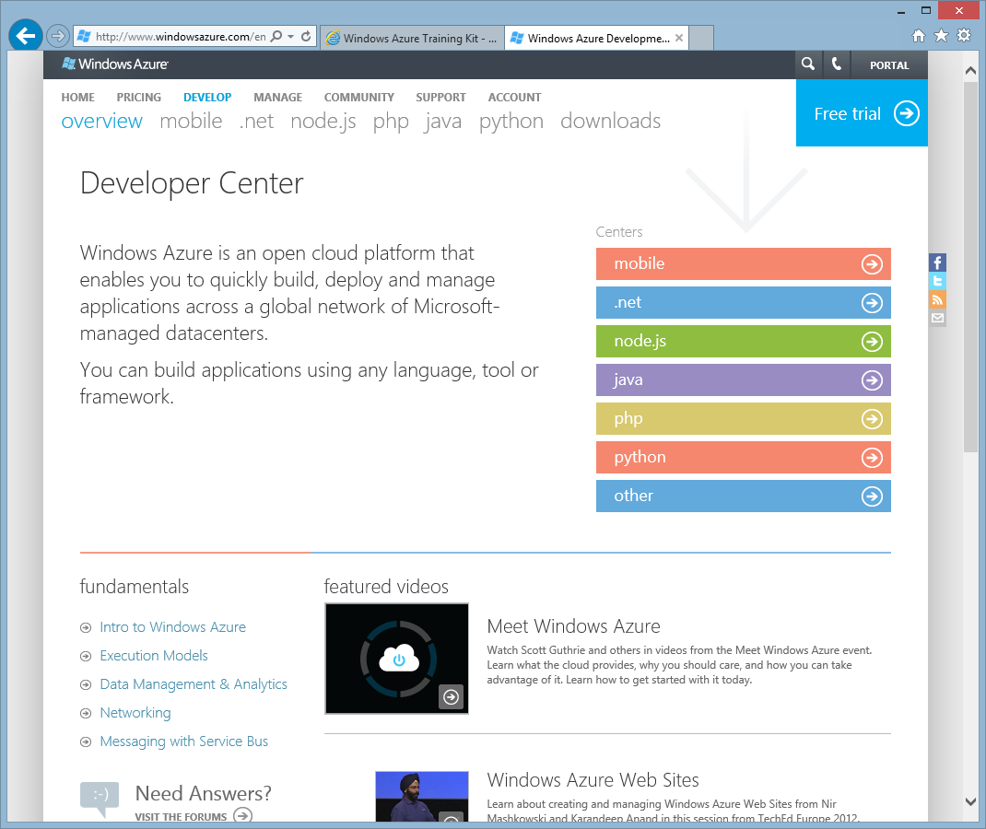
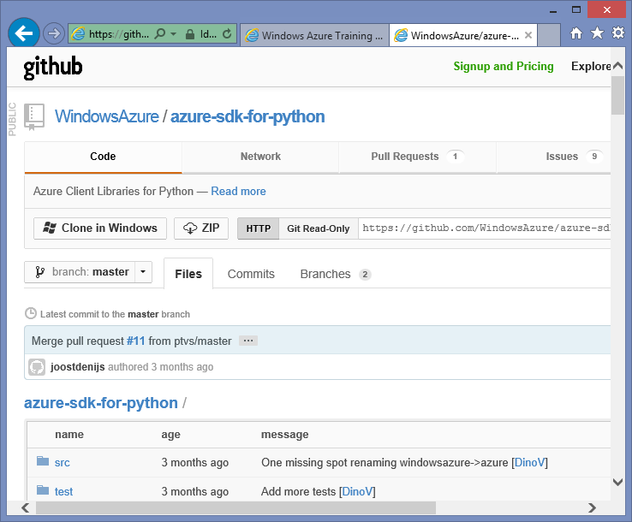
Azure – PaaS and Open!!
SDKs and tools for:
.NET, PHP, Java, Python, node.js
Mobile platforms incl. iOS, Android, WP7
Eclipse, Visual Studio etc.
Most released as OSS
Codeplex & github are primary sources
Generally
All also available as HTTP REST
Integration of any platform possible
Notes:
marioszp

Slide 8

Environments for Running Applications
Virtual Machines
Cloud Services
Web Sites
Mobile Services
Applications
Multi-tier Apps
Web Apps
Mobile Apps
Data
Data
Data
Data
Firewall Rules
End Point Mgmt
Virtual Network
O/S
Infrastructure as a Service
Platform as a Service
Focus on the Application
Notes:
marioszp

Slide 9










Application Building Blocks
Big data
Database
Storage
Storage
Traffic
Caching
Messaging
Caching
Identity
Identity
Media
CDN
CDN
Networking
Notes:
marioszp

Slide 10
3rd-Party Building Blocks (some examples)
Many others…
ClearDB (MySQL)
MongoLabs (MongoDB)
MetricsHub
MongoLabs (MongoDB)
Newrelic
AppDynamics
Paraleap
Newrelic
Partner Media Encoders
Akamai CDN
Akamai
Notes:
marioszp

Slide 11
Migration Strategy to Azure
Migrate the database
Front-end tier migration
Get rid of assets stored on local machine
Deal with session state – adopt Cache with memcached
Leverage identity management services from Azure
Create deployment for Azure
Deploy and test in local emulator
Deploy to the cloud
Notes:
jurgenma

Slide 12
NoSQL on Azure…
Notes:
marioszp

Slide 13

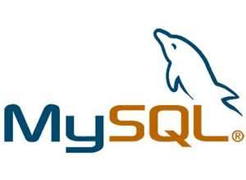

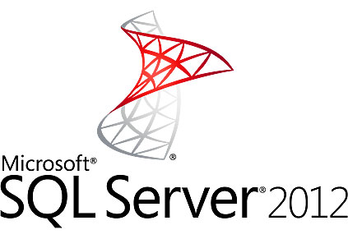

Persistence Options on Azure
SQL
Azure SQL
Azure Tables
NoSQL
Notes:
marioszp

Slide 14
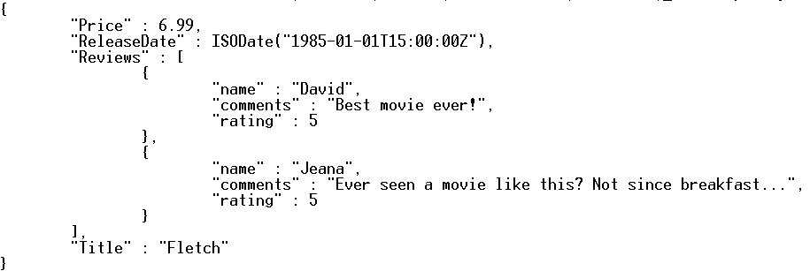
MongoDB and Windows Azure
Document DB
JSON-based serialization
Similar to OO-based data modeling
Queries are SQL-alike
Similar to RavenDB or CouchDB
MongoDB on Azure
MongoLabs – MongoDB-as-a-Service
MongoDB in Azure VM – full control, but maintained by yourself
Notes:
marioszp

Slide 15
Java Apps on Azure Cloud Services (PaaS)…
Notes:
jurgenma

Slide 16
Windows Azure & Java
Java SDK for Windows Azure
Encapsulates access to application building block services
Access to hosting-environment configuration
Open source – available on GitHub
Tooling
Eclipse Plugins for Windows Azure development
Windows Azure Emulator for first local testing & evaluation
Notes:
jurgenma

Slide 17
Front-end #1: No dynamic content locally
Long-term persistence of files → BLOB storage
Remember: compute instances are automatically managed
What do we need to do?
Store all files (e.g. images, excerpts as PDF...) for books in Azure BLOB storage
Use CDN for reduced latency of delivery to end users
Replace URLs to files in database to CDN-content URLs
Notes:
jurgenma

Slide 18
Front-End #2: Deal with Session State
Two options for session state:
Sticky sessions
Use distributed caching for better scalability
We start with sticky sessions (simplicity)
Our future road map: distributed caching
Configure Azure co-located caching
Co-located caches run on compute instances of your own app
Access cache using memcached in your app
Configure memcached session state provider for Tomcat
Notes:
jurgenma

Slide 19
Front-End #3: Identity Management
Leverage claims-based, federated authentication
Allows us to „delegate“ authentication to proven identity providers
For our app: integrate with Azure ACS
Create an Azure Access Control Service namespace
Configure a „relying party“ in Azure ACS for our front-end application
Create X.509 certificate for token signatures
Configure servlet filter based on Azure ACS Java library
Note: AuthZ needs to be done in our application!
Notes:
jurgenma

Slide 20
Get to a deployment on Azure…
Add Azure deployment project
Configure azure deployment project (caching, communication endpoints etc.)
Deploy and test in emulator
Deploy to Windows Azure
Upload Java runtime version to blob storage
Configure app server locally – upload configuration to BLOB storage
Upload your Azure deployment packages to Azure staging & test in staging
Staging OK → VIP SWAP in Azure to production environment
Notes:
jurgenma

Slide 21
Summary
Notes:
marioszp

Slide 22
Summary
Windows Azure Platform-as-a-Service
Automatically managed compute instances and services for our apps
Java on Azure
Java SDK for application building block services available as open source
Eclipse tools for Java simplifies Azure deployments of Java applications
3rd Party Building Blocks
MongoDB-as-a-Service from Mongo Labs
Many others available through Windows Azure store
Notes:
marioszp

Slide 23
Migration Strategy to Azure - Summary
Migrate the database
Front-end tier migration
Get rid of assets stored on local machine
Deal with session state – adopt Cache with memcached
Leverage identity management services from Azure
Create deployment for Azure
Deploy and test in local emulator
Deploy to the cloud
Notes:
jurgenma

Slide 24
Links and Resources
Windows Azure
www.windowsazure.com
Windows Azure SDK for Java
https://github.com/WindowsAzure/azure-sdk-for-java
Eclipse Tools for Windows Azure
http://msdn.microsoft.com/en-us/library/windowsazure/hh694271.aspx
Memcached for Tomcat
http://code.google.com/p/memcached-session-manager/
Spring JPA and MongoDB
http://static.springsource.org/spring-data/data-mongodb/docs/current/reference/html/
MongoLabs
https://mongolab.com/
Book Store Demo GitHub Repository
https://github.com/JMayrbaeurl/GotoZurich2013JavaOnAzureSample
https://github.com/JMayrbaeurl/azure-web
Notes:
marioszp

Slide 25
Thank You!!
http://blogs.msdn.com/mszcool
http://www.codefest.at/author/jm.aspx
Notes:
both

Slide 26
Appendix…

Slide 27

Data Center Locations

Slide 28
SQL-Options on Windows Azure
Windows Azure SQL Database
Database-as-a-Service
Request a new DB, get the connection information and start
SQL Server in Virtual Machines
Self-hosted, full-featured
MySQL on Azure
Self-hosted in VMs
ClearDB = Database-as-a-Service
Others
Self-hosted in VMs
Azure SQL

Slide 29
NoSQL-Options on Windows Azure
Windows Azure Table Storage
NoSQL as a service – HTTP REST API
MongoDB on Azure
Self-hosted – run Mongo in Virtual Machines (Linux & Windows)
Self-hosted in Platform-as-a-Service = automanaged
MongoLabs = MongoDB-as-a-Service
Cassandra, NeoJS and others
Self-hosted in Virtual Machines (Linux & Windows)
Azure Tables

Slide 30
Windows Azure Table Storage
Column-based NoSQL
Similar to Google BigTable or Cassandra
Partitioned storage with primary key
Triple-replicated, strong consistency
Geo-redundant
Massive scale!
200TB, 20K txn / sec
Scale linearly with multiple accounts
SDKs: PHP, Python, Node, Java, .NET
Azure Tables

